Slide 1
Walmart Weekly Sales
By Smita Shah

Slide 2
Table of contents
1
2
3
4
Introduction
Brief overview of the project
Objectives: What are you trying to achieve with this project?
Importance: Why is sales prediction crucial for Walmart?
Dataset Overview
Description of the dataset used for prediction
Source of the dataset
Key attributes/features in the dataset
Data preprocessing steps (if any)
Exploratory Data Analysis (EDA)
Visualizations of the dataset (e.g., histograms, scatter plots, etc.)
Insights gained from EDA
Any correlations or patterns observed
Feature Engineering
Explanation of any feature engineering techniques used
Transformation of data (e.g., normalization, scaling)
Creation of new features

Slide 3
Table of contents
5
6
7
Model Selection
Overview of different machine learning models considered
Justification for choosing a specific model
Explanation of why the chosen model is suitable for this prediction task
Model Training & Evaluation
Description of the training process
Hyperparameters used for training
Evaluation metrics used to assess model performance
Performance metrics of the trained model on test data
Future Improvements
Potential enhancements to the model or methodology
Additional features that could improve prediction accuracy
Ways to optimize model performance
8
Conclusion/Questions
Summary of key findings

Slide 4
1
Walmart, a leading US retail chain, aims to enhance sales and demand forecasting accuracy. Various events and holidays significantly influence daily sales. With sales data accessible for 45 Walmart stores. Walmart conducts promotional markdown events, particularly preceding major holidays such as the Super Bowl, Labor Day, Thanksgiving, and Christmas. Weeks encompassing these holidays carry a weight in evaluation compared to regular weeks. The dataset includes historical sales records for Walmart's 45 stores across diverse regions.
INTRODUCTION

Slide 5
Objectives: What are you trying to achieve with this project?
Importance: Why is sales prediction crucial for Walmart?
Create two machine learning models with:
predicting sales on holidays
forecast weekly sales figures accurately
Enabling businesses to optimize inventory management, predict revenue streams, and make informed strategic decisions
Sales prediction is vital for Walmart to optimize inventory, allocate resources efficiently, plan promotions effectively, manage finances, and enhance customer satisfaction.

Slide 6
Description of the dataset used for prediction Store - the store number Date - the week of sales Weekly_Sales - sales for the given store Holiday_Flag - whether the week is a special holiday week; 1 – Holiday week 0 – Non-holiday week Temperature - Temperature on the day of sale Fuel_Price - Cost of fuel in the region CPI – Prevailing consumer price index Unemployment - Prevailing unemployment rate Holiday Events - Super Bowl: 12-Feb-10, 11-Feb-11, 10-Feb-12, 8-Feb-13\ Labor Day: 10-Sep-10, 9-Sep-11, 7-Sep-12, 6-Sep-13\ Thanksgiving: 26-Nov-10, 25-Nov-11, 23-Nov-12, 29-Nov-13\ Christmas: 31-Dec-10, 30-Dec-11, 28-Dec-12, 27-Dec-13
2
Dataset Overview
DATASET:
https://www.kaggle.com/code/yasserh/walmart-sales-prediction-best-ml-algorithms

Slide 7
Exploratory
Data
Analysis
3

Slide 8
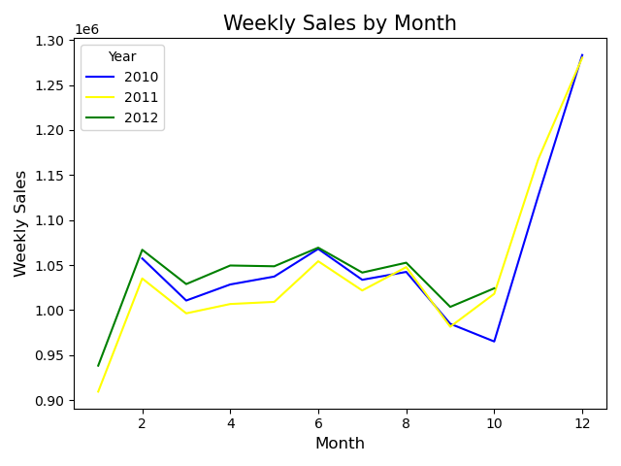
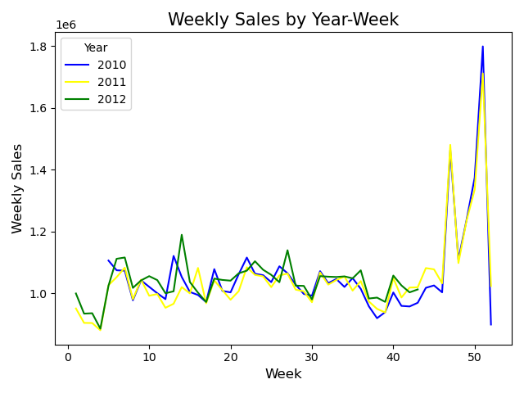
Weekly sales by Month shows the consistency of the weekly sale trend throughout the year
Analyzing weekly sales by Year-Week reveals crucial insights into the impact of holidays on sales trends.
Significant spike around week 50

Slide 9
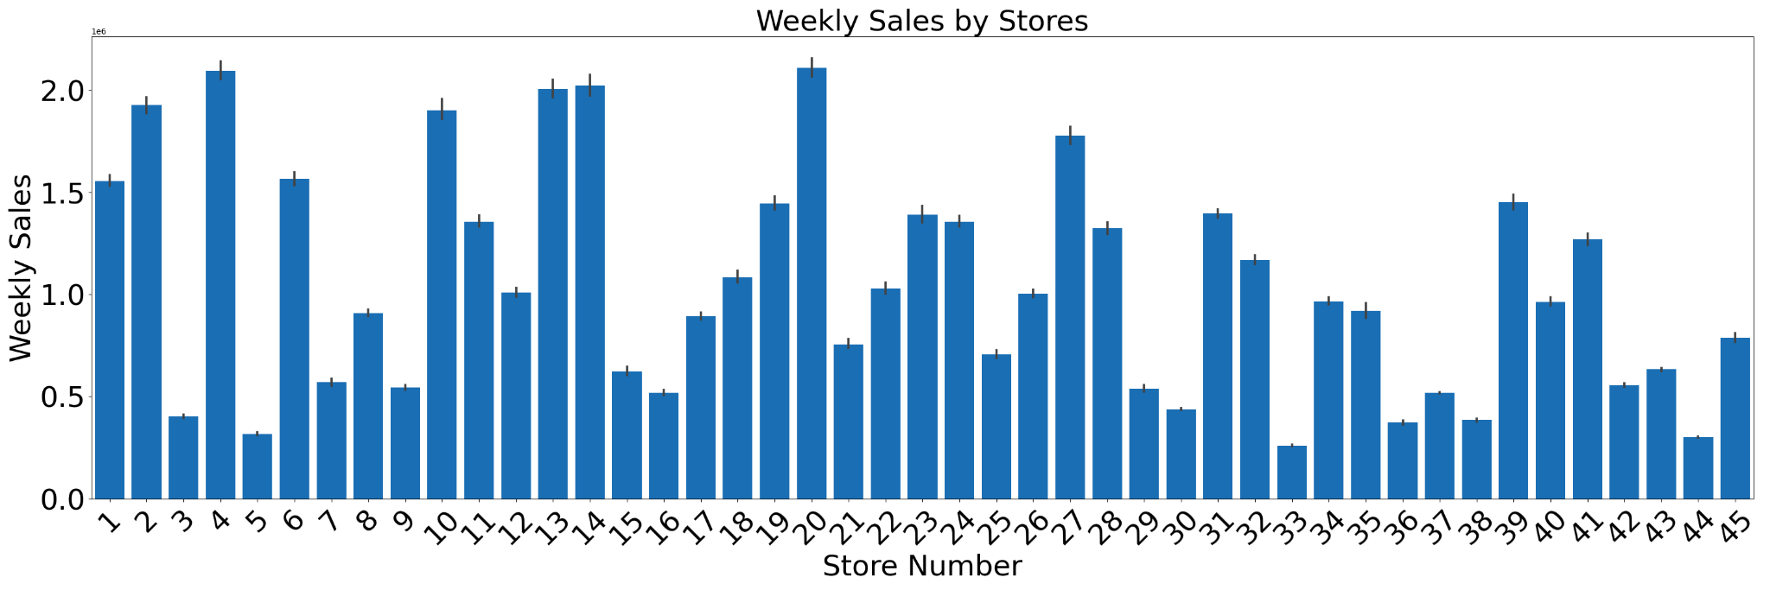
☆
☆
Displays Top-performing stores within the region
Top stores have sales of ≈ $2 million

Slide 10
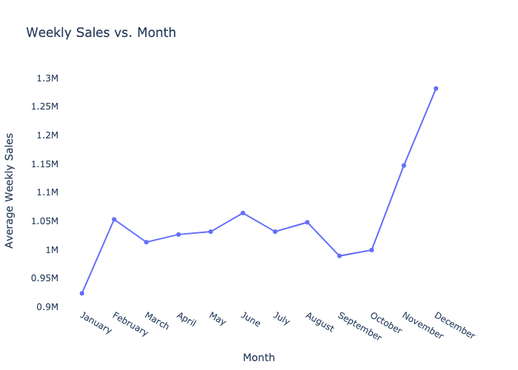
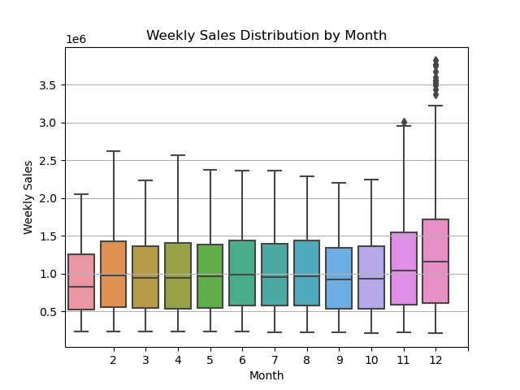
December has highest weekly sales
Holiday shopping

Slide 11
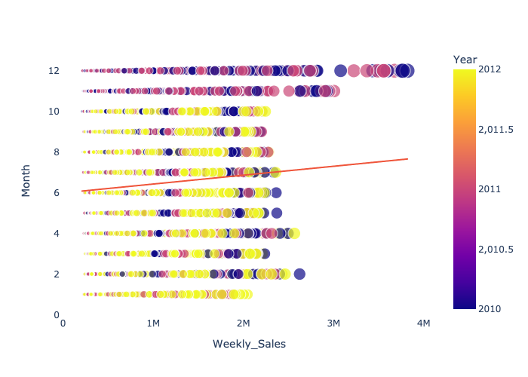
The regression line shows a general positive trend throughout the later months of the year

Slide 12
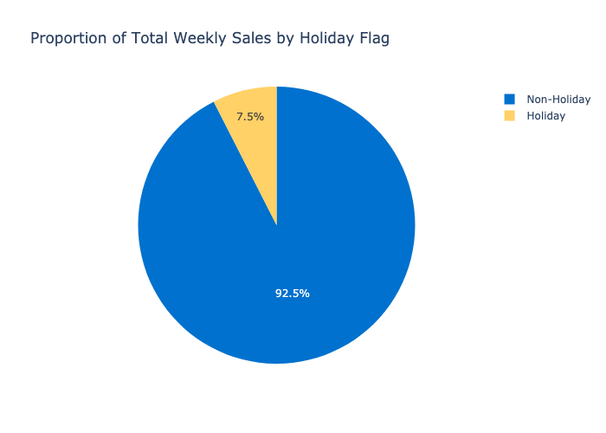
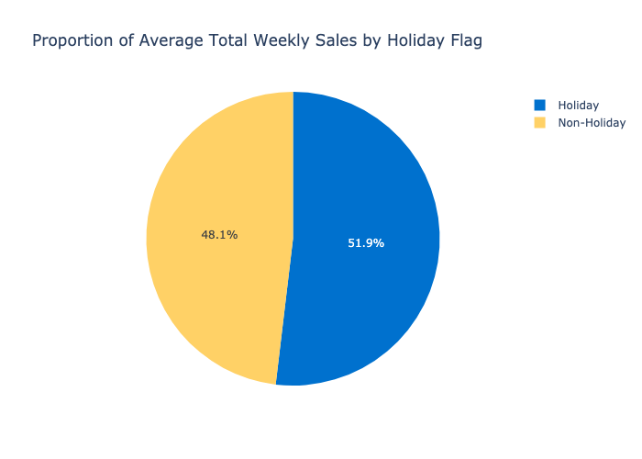
Shows total sales from holiday & non-holiday categorized sales days
Average sales provides insight into the large number of sales occurring during the holidays and scales it to be comparable to non-holidays

Slide 13
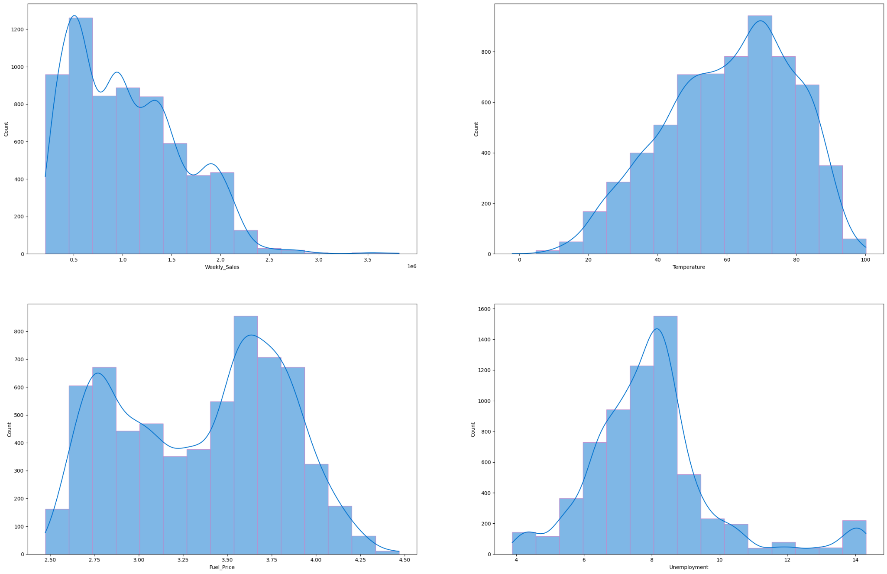
Skewed right
There is more frequency for weeks with lower weekly sales.
Skewed left
It is more likely that the warmer the weather, the more sales there are.
When there are lower unemployment rates there are more sales.
Symmetrical
Theres 2 fuel prices that drive sale counts up, $2.75 & $3.50.

Slide 14
4
Feature Engineering

Slide 15
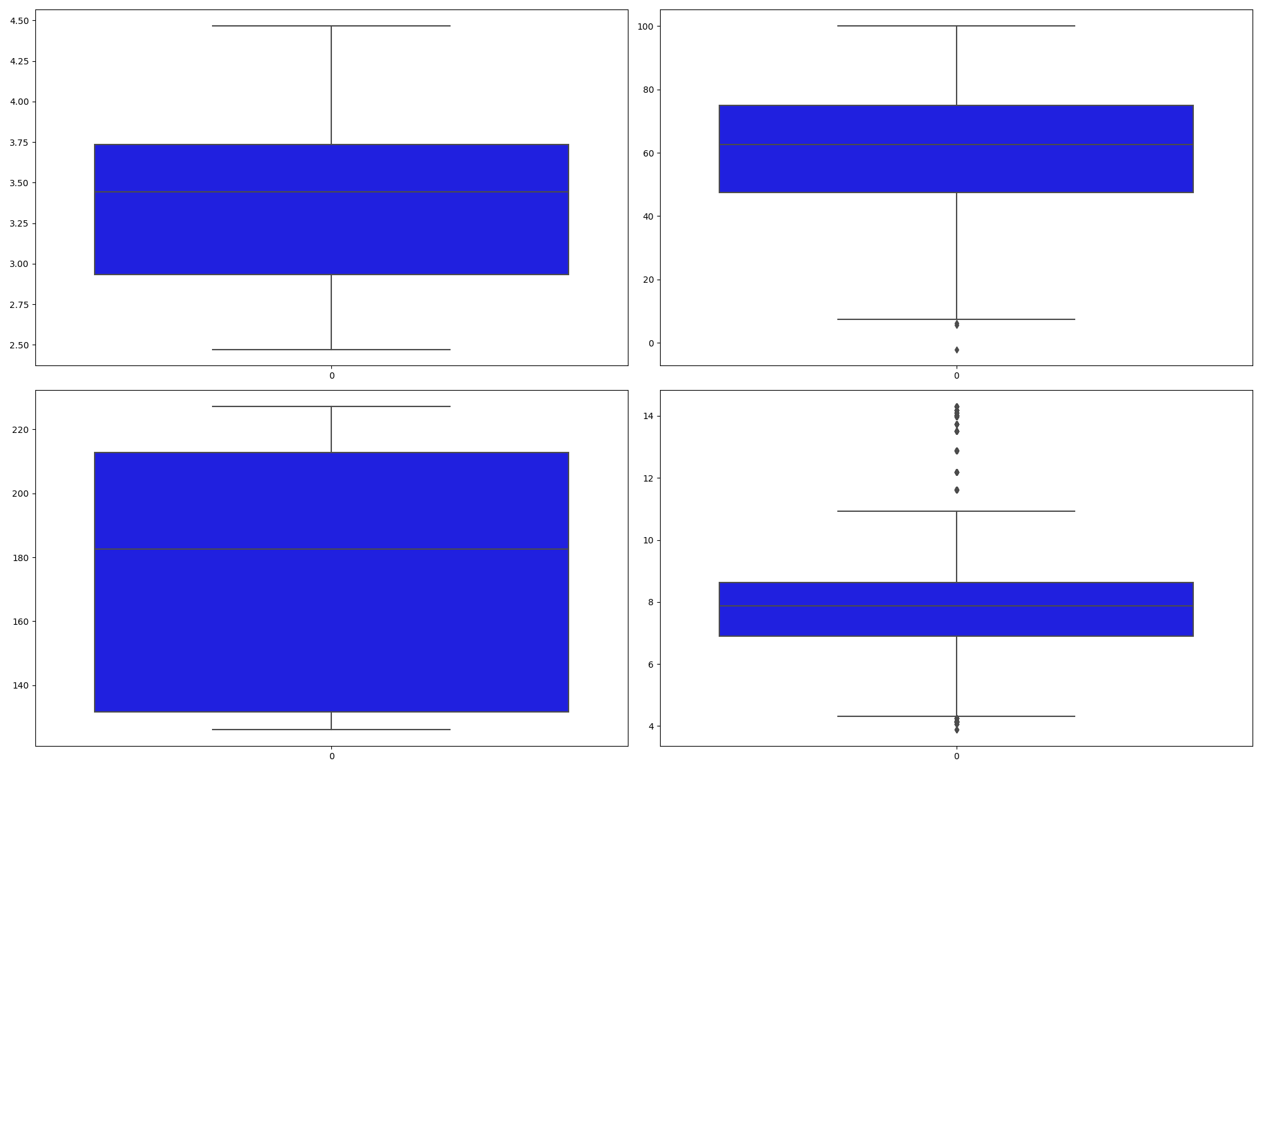
2
3
1
5
4
6
7
Extract year, month and day from date
Convert to number format
Convert Date to date-time object
Week, month
Split data into training and testing sets
Scale Data
Create a quarterly column
Create standard scalar instance, fit the StandardScalar, Scale the data
Remove Outliers
Machine Learning Model for Weekly_sales Prediction
Notes:
HOLIDAY PREDICTION MACHINE LEARNING
y = df['Holiday_Flag']
X = df[['Weekly_Sales', 'Store', 'Unemployment',
'Fuel_Price', 'CPI', 'Week', 'Temperature', 'Month', 'Year']]
WEEKLY_SALES PREDICTION MACHINE LEARNING
y = df['Weekly_Sales']
X = df[['Store', 'Holiday_Flag', 'Temperature',
'Fuel_Price', 'CPI', 'Unemployment', 'Month', 'Year', 'Week']]

Slide 16
Model Selection

Slide 17
1
2
3
4
Deep Learning Model
Linear Regression Model
Main focus: Holiday’s
Main focus: Weekly Sales Prediction
Logistic Regression Model
Polynomial Regression Model
Main focus: Holiday’s
Main focus: Weekly Sales Prediction

Slide 18
Model Training & Evaluation
6

Slide 19
Deep Learning Model
92.98% Accuracy
Define Model
Compile Sequential model and customize metrics
Used optimizer “adam”
Train
50 Epochs
Evaluate using test data:

Slide 20
Logistic Regression Model
93% Precision, Weighted Avg. of 86%
Import from SKLearn
Assign random_state parameter
Random_state parameter = 1
Fit the model using training data
Make a prediction using the testing data
Generate Confusion Matrix
Print Classification Report:

Slide 21
Linear Regression Model
Split data for train and test
Split data into Numerical and Categorical features
Create data transformation pipeline
Fit the training data
Transform the training and testing data
Fit the data to the Linear Regression Model
Create a function to distribute our plot
Plot the predicted values using training data compared to the actual values of the training data

Slide 22
Polynomial Regression Model
Define model_evaluation
Predict data using X Train and X Test
Tune our parameters
Function to find best set of hyperparameters to optimize performance
Fit the data to the Polynomial Regression Model
Use our best parameter
Test for training accuracy
Plot predicted values compared to actual

Slide 23
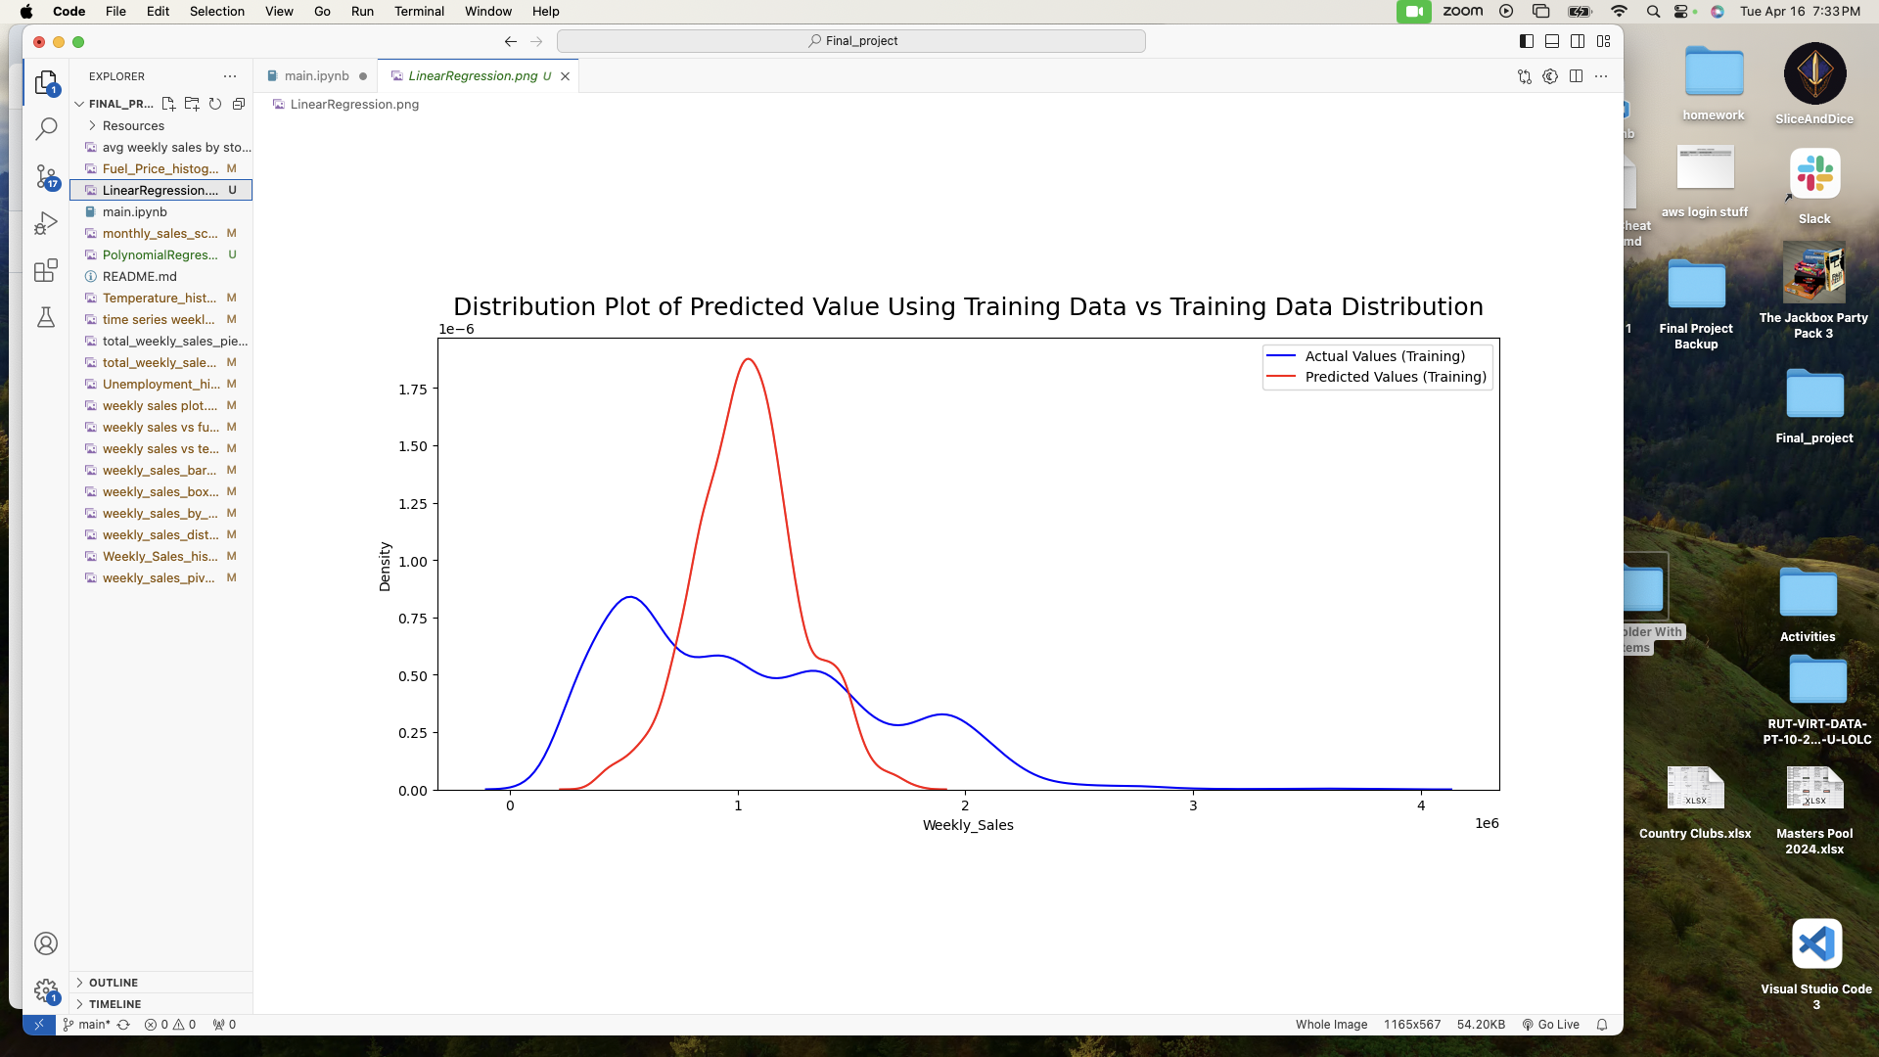
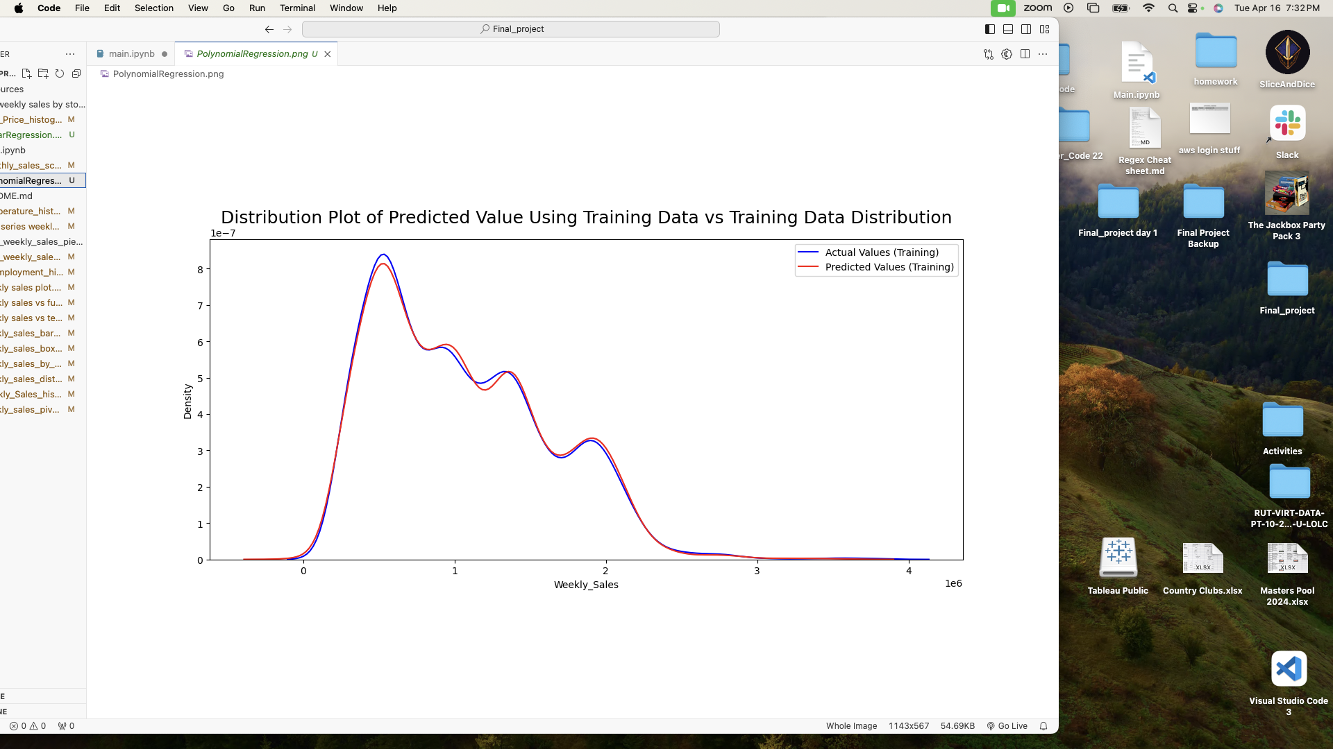
Linear Regression Model
Polynomial Regression Model

Slide 24

7
Future Improvement

Slide 25
Obtain a more up-to-date dataset
Data Gathering Limitation
Increase the dataset size
The current dataset is from 2010 -2012
Walmart does not allow access to the general public
We have data for 45 stores

Slide 26
8
Conclusion

Slide 27
Accurate Models
Both models predicting Holiday’s were above 90% while the Polynomial Regression model was very close to prediction actual sales Walmart experienced

Slide 28

QUESTIONS

